Slide 1
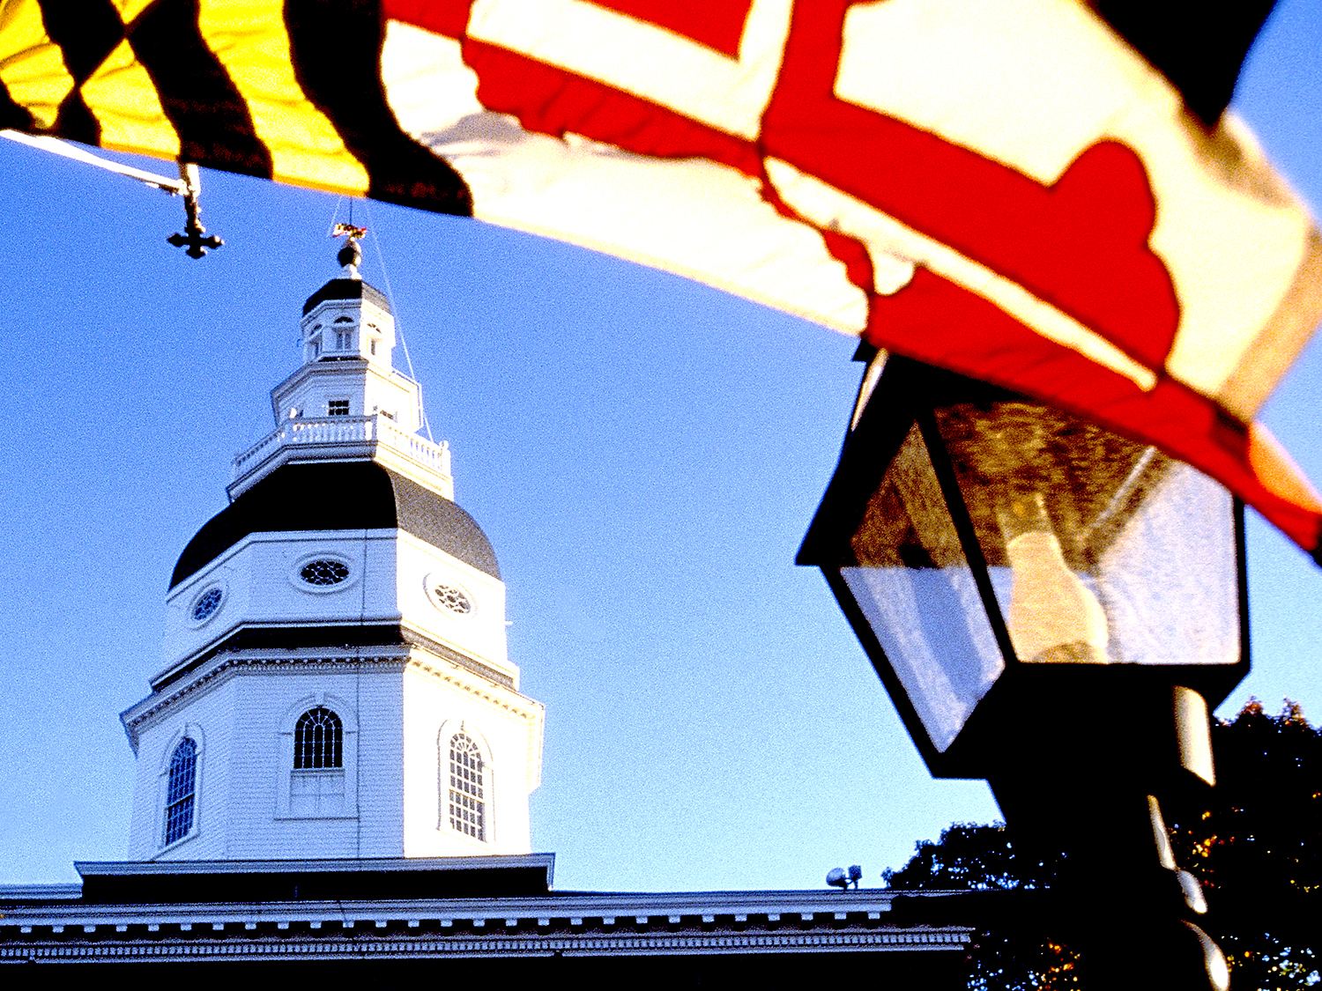
OPEN FOR BUSINESS

Slide 2
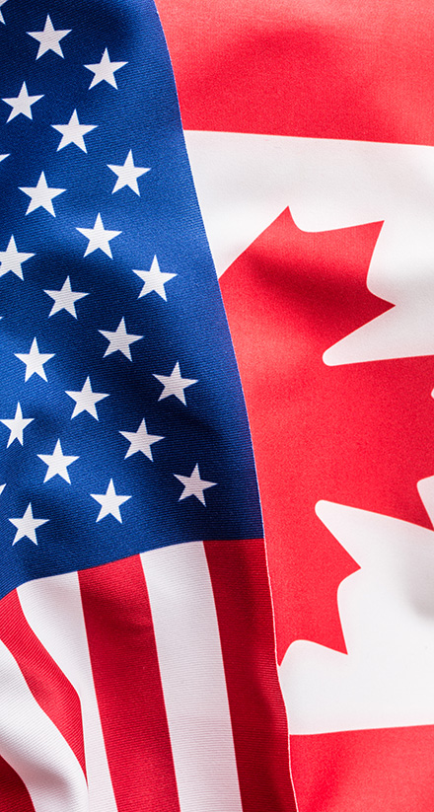
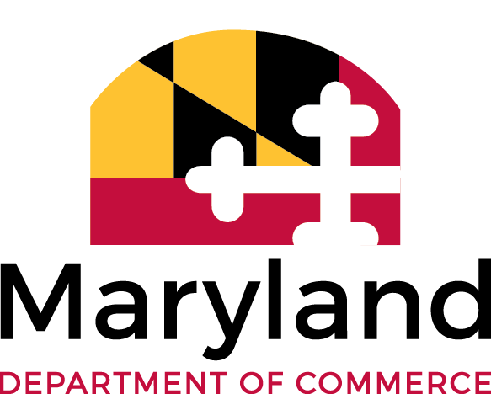
Maryland – Canada
Trade & Investment
205,500 jobs in Maryland depend on Canada–U.S. trade and investment
Canada is Maryland’s #1 export market
Total Canada–Maryland goods trade: $3.3 billion

Slide 3
Canadian Companies in Maryland
CGI Global information technology consulting, systems integration and solutions company employs over 600 employees in Annapolis Junction, Baltimore and Lexington Park.
OpenText Canada’s largest software company, employing more than 10,000 globally, including 417 Marylanders in Gaithersburg.
Stantec Canada's second largest professional services firm employs 190 in Baltimore, Germantown and Laurel, where they support State infrastructure and architecture projects.

Slide 4
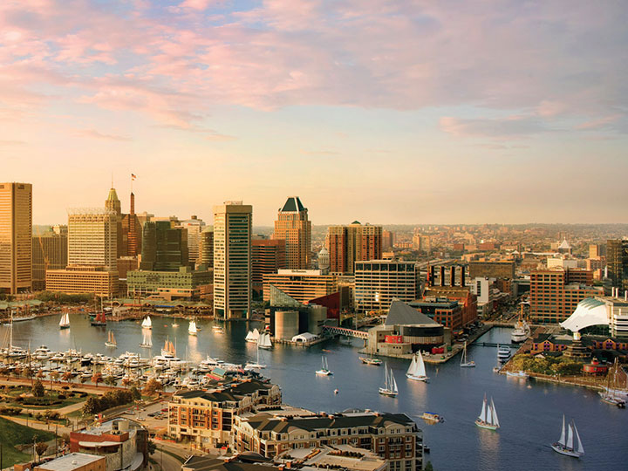
Why Choose Maryland?

Slide 5
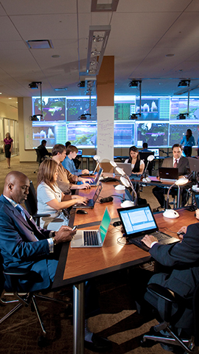
Thriving Industries
IT & Cybersecurity
US CyberCommand, NSA, 116,000 workers
Aerospace & Defense
14 of top 25 aerospace companies, UAS, satellites
Logistics & Distribution
Strategic mid-Atlantic location
BioHealth & Life Sciences
2,260+ companies, NIH, FDA, JHU
Advanced Manufacturing
2,360 companies
Financial & Professional Services
T. Rowe Price, Legg Mason, Morgan Stanley
Military & Federal
20 military installations, 60+ federal agencies

Slide 6



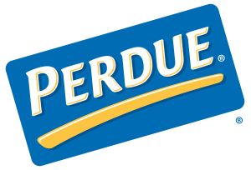
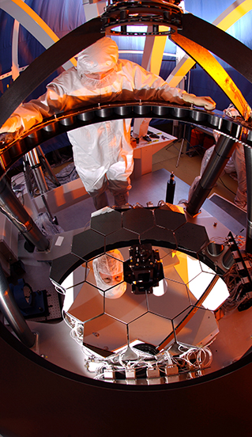









Innovative
Business Leaders

Slide 7
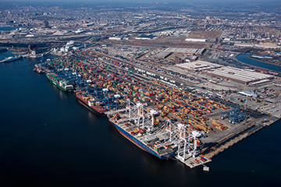
Transportation Infrastructure
Access to 4 International Airports
BWI, Reagan, Dulles, PHL
Major Highways
Interstates include 95, 81, 83, 70 and 68
2 Class I Rail Lines
CSX, Norfolk Southern
ACELA Express
Baltimore to NYC in 2 hours
Port of Baltimore
Super post-Panamax cranes, closest to Midwest

Slide 8
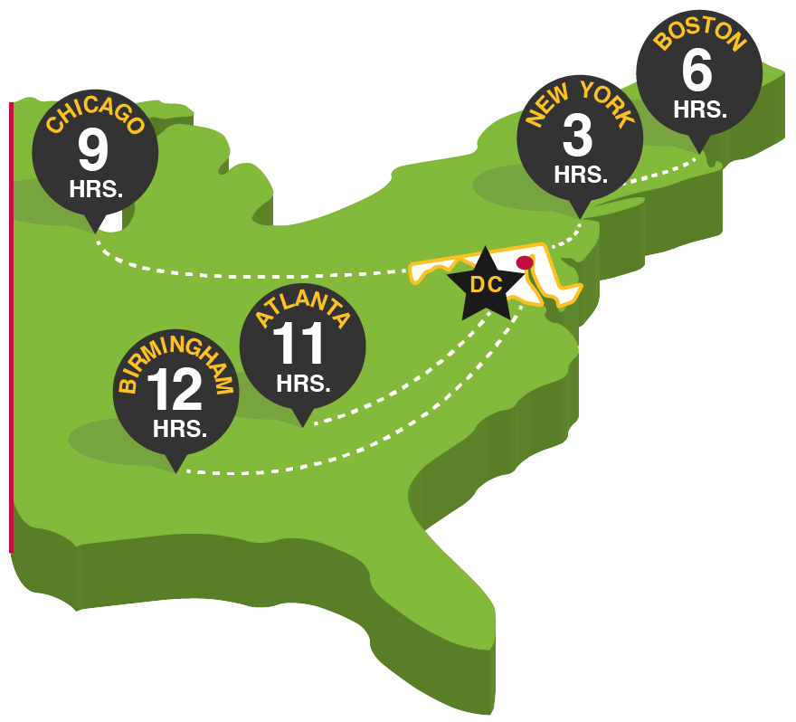
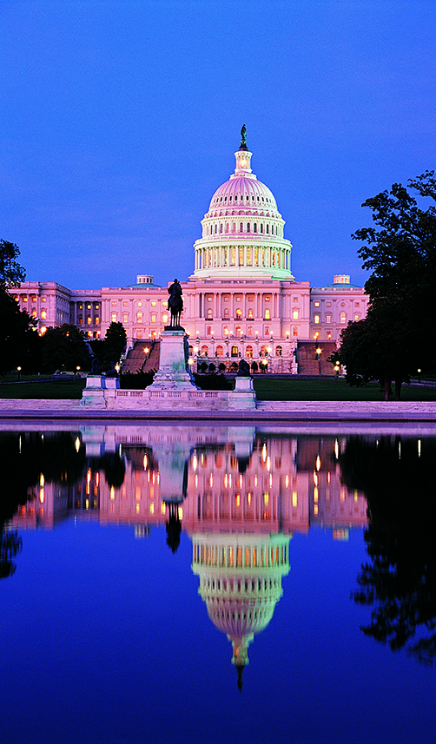
Strategic Location
Next-door to the nation’s capital, Washington, D.C.
The Port of Baltimore is closer to the Midwest than any other Atlantic seaport
Within overnight drive to
1/3 of U.S. population and industrial base

Slide 9
Top-Ranking R&D
74 federal laboratories — more than twice as many as any other state
60+ federal agencies
#3 on the Milken Institute Technology & Science Index
#1 for federal R&D obligations ($16.8 billion)
350 federal and academic research centers
30+ incubators/research parks

Slide 10
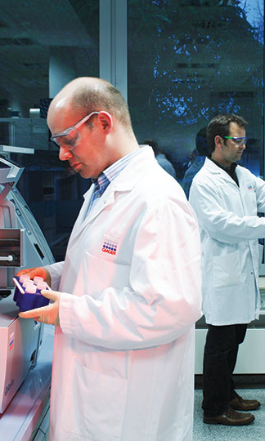
Workforce and Education
#1 in concentration of doctoral scientists and engineers
#1 in concentration of professional and technical workers
#2 nationally in high school senior AP exam scores
#3 in % of population age 25 and above with graduate or professional degree or higher
57 accredited colleges and universities
Notes:
#1 in professional and technical workers (See Maryland RANKINGS in SF)
Technology & science workforce http://statetechandscience.org/statetech.taf?page=overall-ranking&composite=tswf (Milken report 2016)
# 3 academic R&D intensity (See Maryland RANKINGS in SF)
# 3 in STEM professionals https://wallethub.com/edu/most-innovative-states/31890/
#5 Information technology jobs http://msa.maryland.gov/msa/mdmanual/01glance/economy/html/employ.html#tech

Slide 11
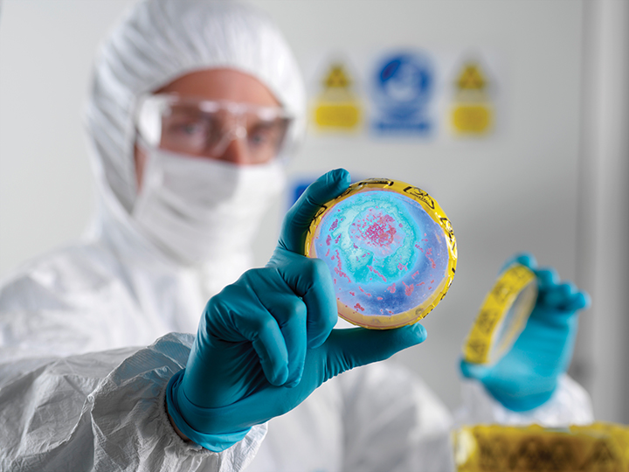

BioHealth and Life Sciences

Slide 12
Industry Snapshot
2,360 life sciences companies
41,570 life sciences employees
$17.42 billion in economic activity
$1.55 billion in federal procurement
Close proximity to NIH, FDA, NIST
Notes:
See 09/17 Industry sector binder page for data.
Used the combined employee # (private & public sector)

Slide 13

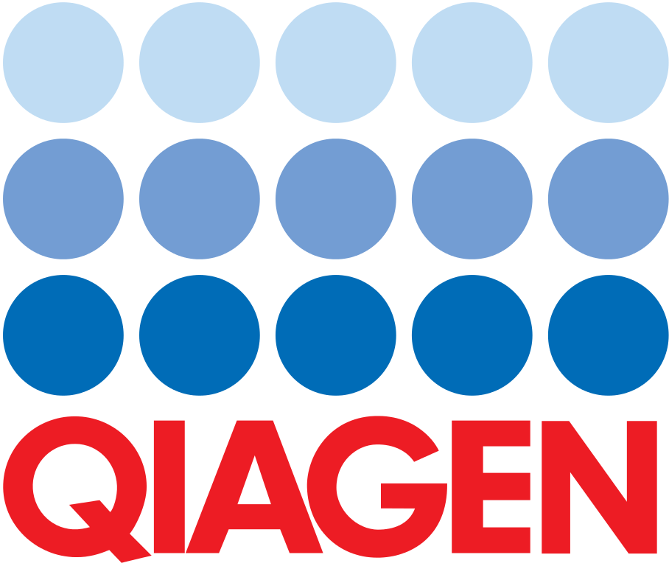


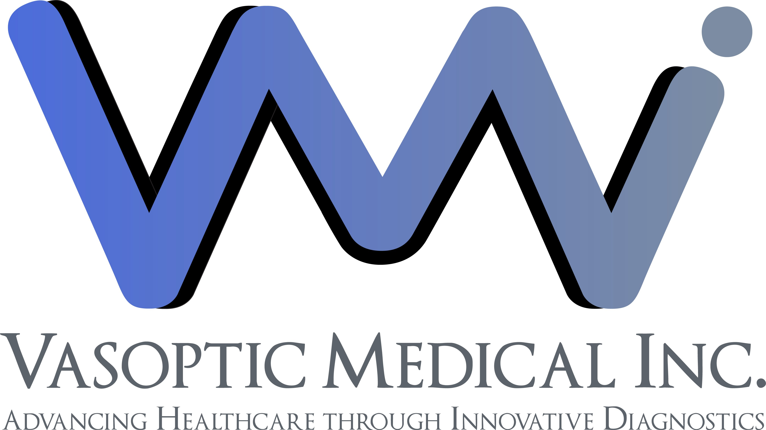
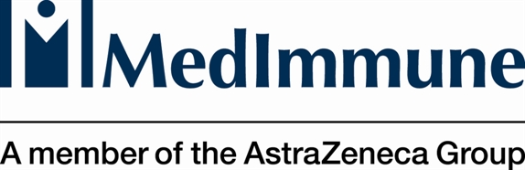
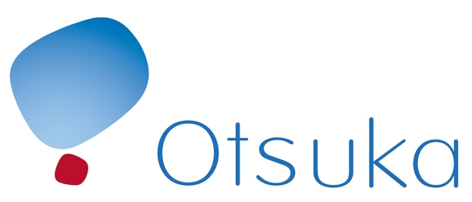



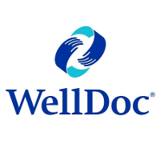
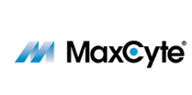





BioHealth & Life Sciences Leaders

Slide 14
Biotech Tax Credit
From FY2007 to FY2016 Maryland’s highly successful and generous (50%) Biotechnology Investor Incentive Tax Credit attracted $169 million in total capital investment into Qualified Maryland Biotechnology companies.

Slide 15
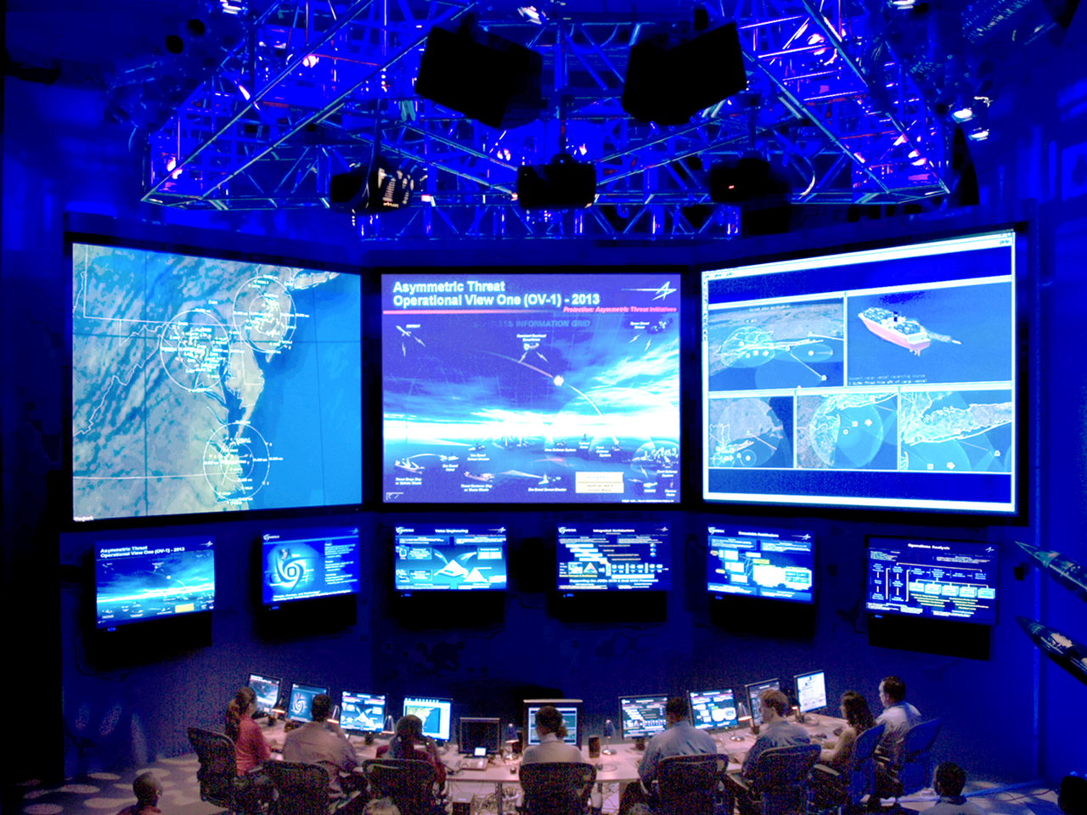
Cybersecurity in Maryland

Slide 16
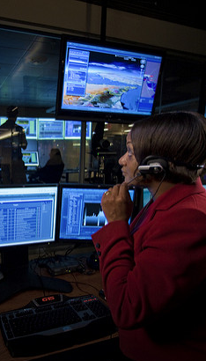
Major Cyber Assets
60+ federal agencies
74 federal laboratories
20+ military facilities
30+ business incubators and accelerators

Slide 17
One-of–a–kind
Cyber Resources
  National Security Agency &
  U.S. Cyber Command
  (Fort Meade)
  Johns Hopkins University Applied Physics Lab
  National Institute of Standards & Technology (NIST)

Slide 18
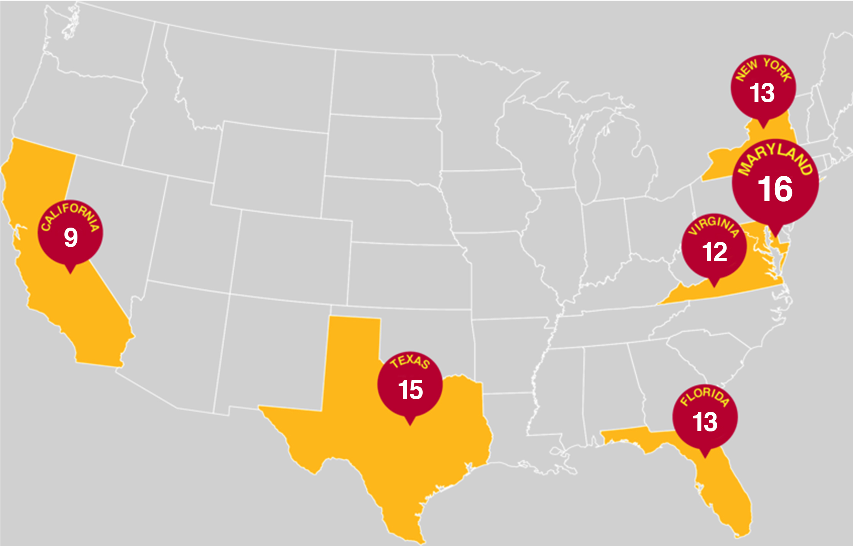
#1 in the nation
16 higher education institutions designated by the NSA/DHS as National Centers of Academic Excellence in Cyber Defense education and research.

Slide 19







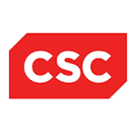


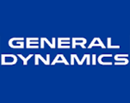

Defense Contractor Concentration

Slide 20




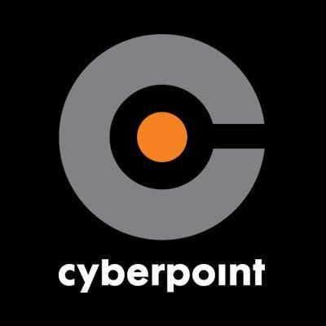





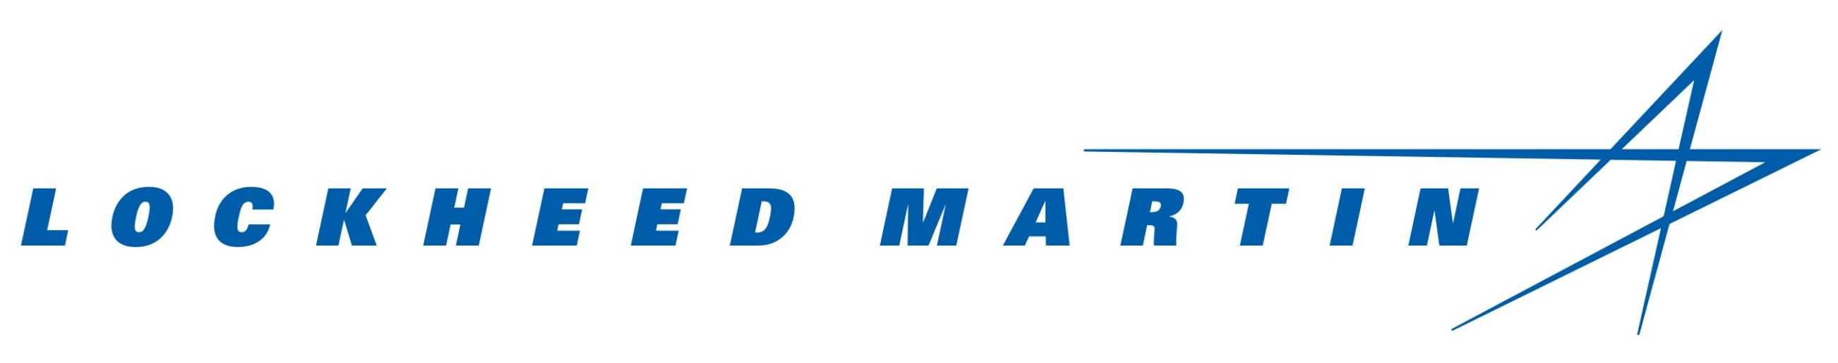
Cyber Thought Leaders

Slide 21
Excel Maryland
Comprehensive, statewide strategy to accelerate the growth of Maryland’s cybersecurity and biohealth & life sciences industries.
A collaborative effort between government, industry, economic development and higher education institutions to make Maryland the epicenter for cyber and bio.
Companies that start up in Maryland can grow, thrive, and lead…without ever stopping.
Notes:
#1 in professional and technical workers (See Maryland RANKINGS in SF)
Technology & science workforce http://statetechandscience.org/statetech.taf?page=overall-ranking&composite=tswf (Milken report 2016)
# 3 academic R&D intensity (See Maryland RANKINGS in SF)
# 3 in STEM professionals https://wallethub.com/edu/most-innovative-states/31890/
#5 Information technology jobs http://msa.maryland.gov/msa/mdmanual/01glance/economy/html/employ.html#tech

Slide 22
Maryland’s got it all
Beaches, mountains, forests, farms, cities, and small towns.
Arts and Culture
All across Maryland you’ll find music, theater, art, great food and drink as well as a rich history that reaches back to the earliest days of our country.
Easy Access
Washington, D.C., Philadelphia, New York City and other destinations are a short trip away.

Slide 23
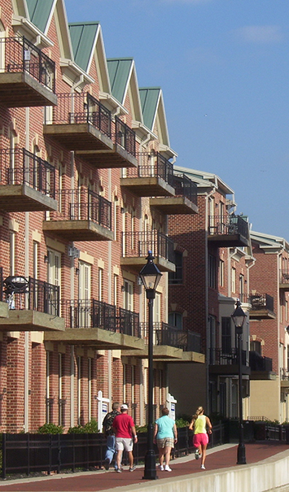
Affordable Living
Cost of Living Index U.S. Metropolitan Areas 2016
(avg. for all urban areas = 100.0)
Baltimore, MD 115.6
Middlesex-Monmouth, NJ 116.3
Chicago, IL 118.5
Philadelphia, PA 118.6
Portland, OR 128.5
Arlington, VA 143.1
San Diego, CA 144.4
Boston, MA 148.1
San Francisco, CA 177.4
New York (Manhattan), NY 228.2
Source: C2ER Cost of Living Index, 2016 Annual Average Data

Slide 24
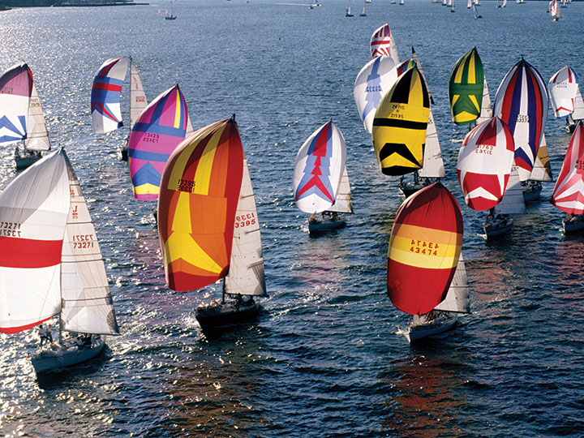
A Great Place to Visit
Maryland welcomed more than 43 million visitors in 2016
Visitor spending topped $17.3 billion
40 hospitality companies have formed “Maryland Welcomes Canadian Travelers,” an alliance that offers promotions and savings of up to $1,000 per visitor.

Slide 25
commerce.maryland.gov
commerce.maryland.gov
0417

